Slide 1
Insurance charges analysis
Analysing factors that affect health insurance cost
Hal Pointon
Newto data analysis

Slide 2
Dataset overview
The data is made of 7 columns and 1338 rows:
Age: age of person
Sex: sex of person
BMI: body mass index of person, bmi = weight (kg)/height (m) ²
Children: how many children person has.
Smoker: whether person smokes.
Region: which region person is from
Charges: how expensive health insurance is in USD.
Each row represents a different person.
The aim of this analysis is to find which of the first 6 factors affects charges and how much.
Secondary aim is to design a machine learning model to incorporate into company website for people to predict their health insurance prices.
The dataset came from Kaggle (https://www.kaggle.com/datasets/teertha/ushealthinsurancedataset).

Slide 3
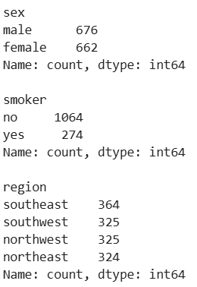
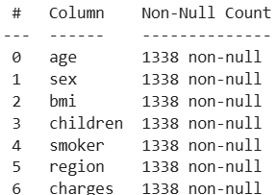
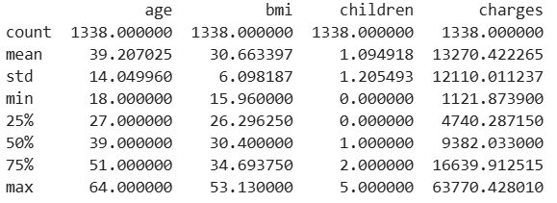
Data cleaning
3
1
Data cleaning steps:
All column were checked for null values: none were detected.
Categorical columns were analysed for misspellings or values repeated in a different format: none were detected.
Quartiles of quantitative columns were analysed for invalid data: none were detected.
The dataset was analysed for duplicate rows: one was detected and removed.
That concluded the cleaning process
2
4

Slide 4
New columns
New columns were added to categorise age and bmi
BMI was split into 5 categories based on current CDC guidelines.
BMI < 18.5: underweight.
18.5 <= BMI < 25: healthy.
25 <= BMI < 30: overweight.
30 <= BMI < 40: obese.
40 <= BMI: Severely obese.
Age was split into 3 categories:
Age < 30: young adult.
30 <= age <= 60: middle aged.
60 < age: senior.

Slide 5
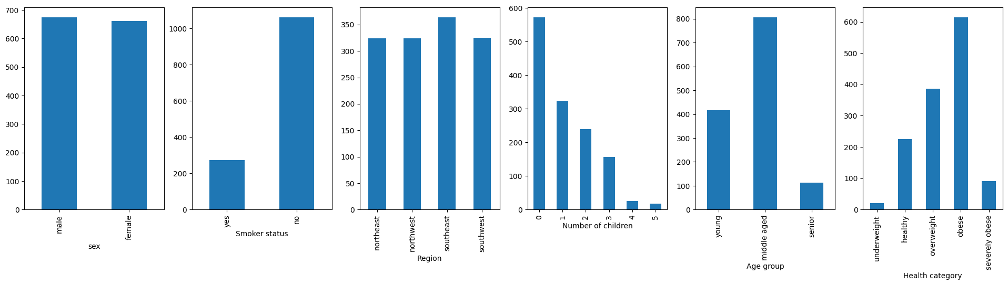
Column distributions (1)
Count plots were generated for each of the categorical variables. They found that:
Most of the people did not smoke.
Fewer children were more common than more children
Most of the people were middle aged, with more young people than seniors.
Most of the people were at least overweight according to their BMI, with some healthy and a very small number of underweight records. This makes our dataset unhealthier than the US average, with 64% of adults nationally being at least overweight (ours is 81%)¹.
Sex and region of the people were mostly even.
¹CDC BMI data

Slide 6
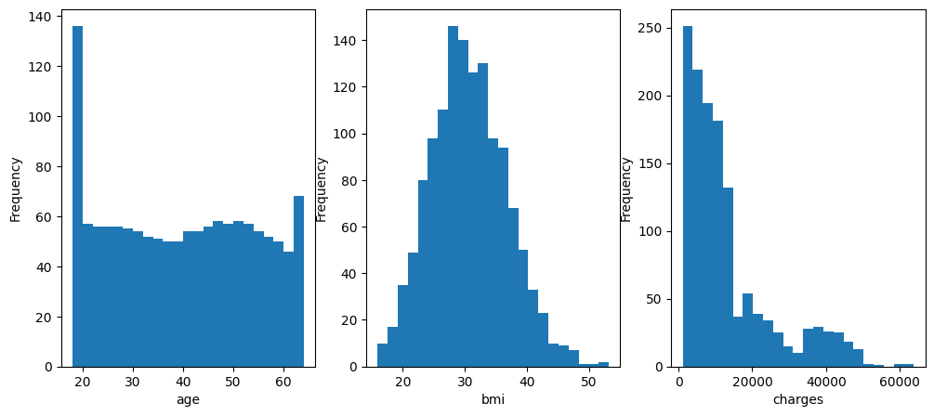
Column distributions (2)
Histograms were generated for each of the categorical variables. They found that:
Age was very even apart from a large peak indicating twice as many 18- and 19-year-olds as other categories.
BMI had a slight positive skew, but is mostly bell shaped, indicating a mostly normal distribution
Charges has a positive skew, indicating that a few people are being charged much more than the median.

Slide 7
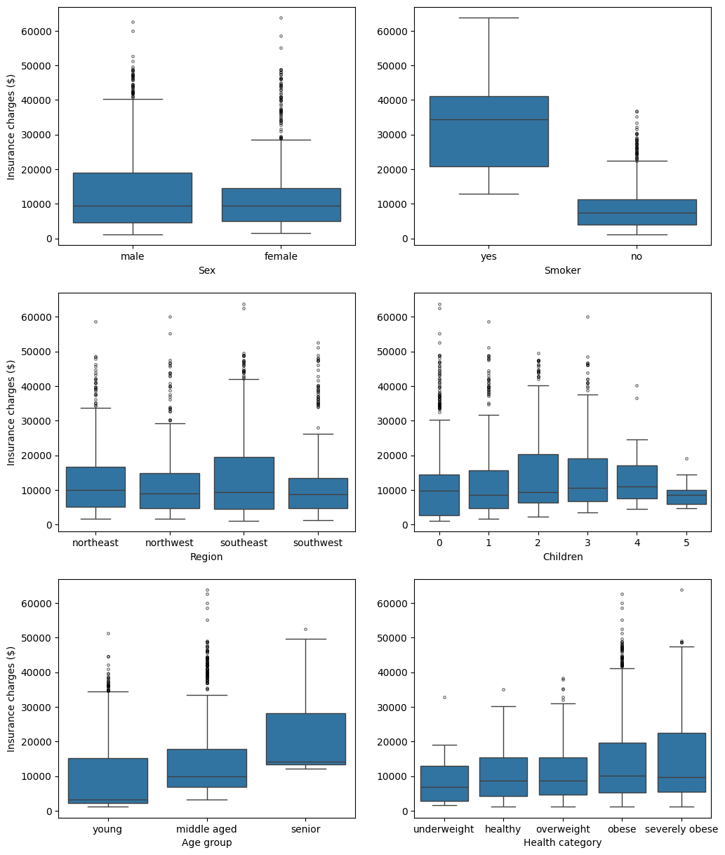
Boxplots analysing insurance charges
Initially I began by creating boxplots comparing the 6 categorical variables to insurance charges to see the effect.
Immediately we can see that smoker status has a very large effect on insurance costs, with the upper quartile of non-smokers experiencing lower costs than the lower quartile of smokers.
Age also has an effect, although not as drastic as smoker status.
Health category seems to have a small impact but only on the upper quartile, with median values being very similar across categories.
Small but likely random variations can be seen in sex, region, and number of children.

Slide 8
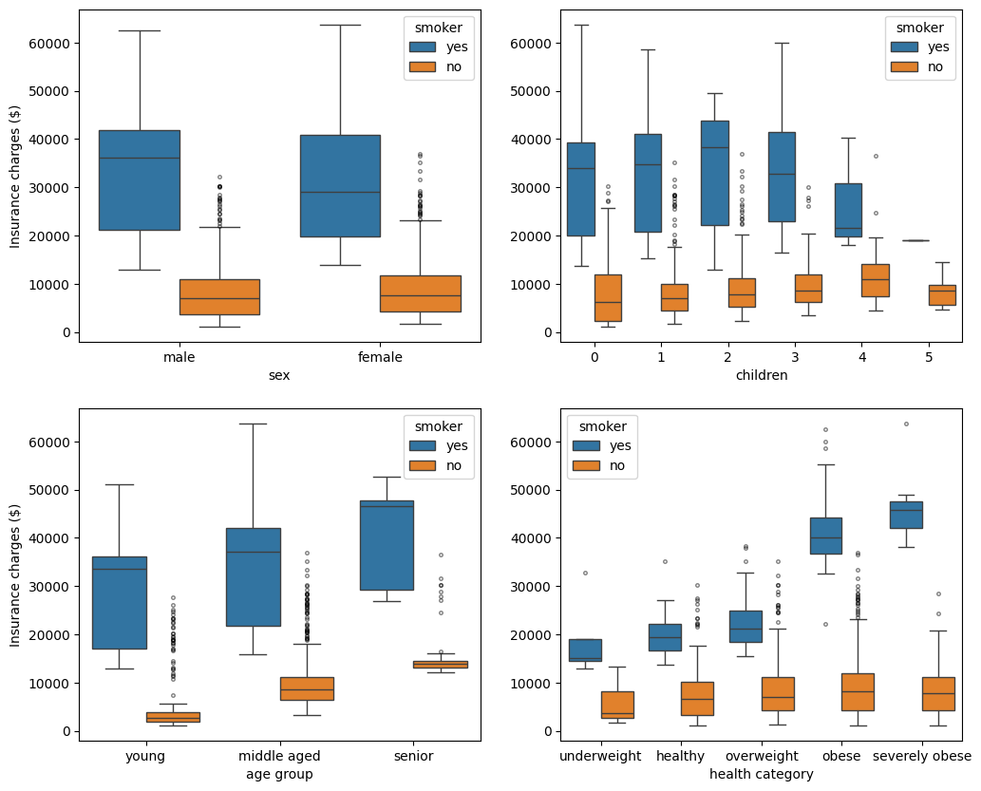
Boxplots controlling for smoking
Because of how large the effect of smoking was, I wanted to re-analyse the other variables, controlling for smoking status.
Any variations in cost for sex and number of children are further reduced.
Age is still correlated with higher insurance costs; the effect is larger in non-smokers than smokers.
Health category only seems to affect insurance costs, if the person smokes. If they don’t, it appears only to have a small effect.

Slide 9
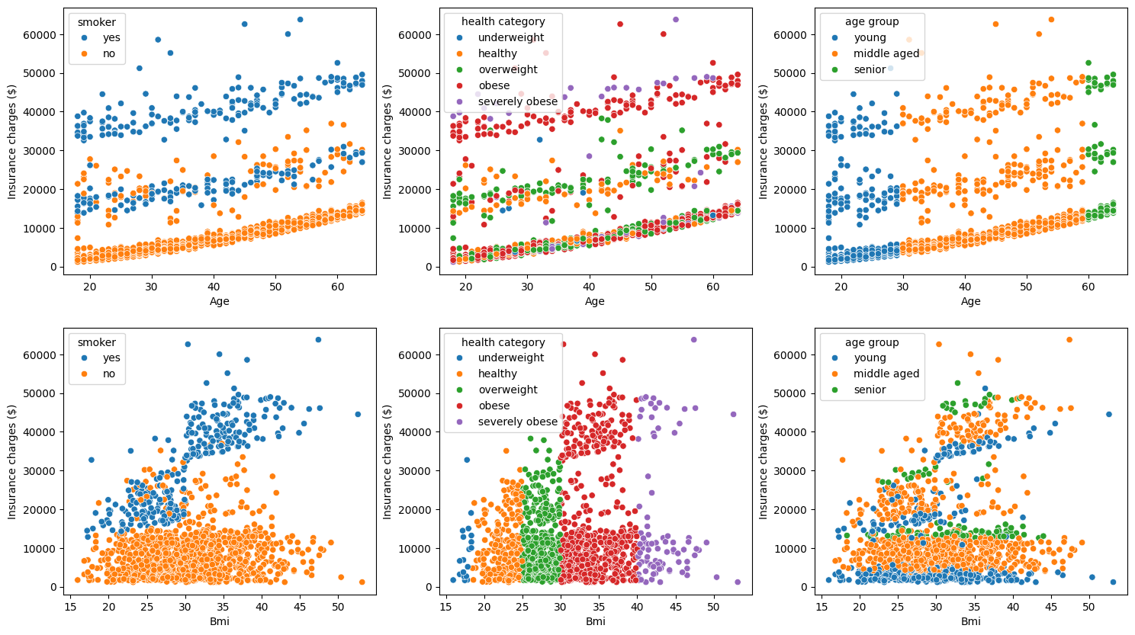
The same trends can be seen for the continuous variables.
BMI shows only a small correlation to insurance charges on its own (R² = 0.20).
But once the data is split by smoking status that correlation jumps to 0.81 for smokers and drops to 0.08 in non-smokers.
This reinforces the fact that BMI only negatively affects health insurance costs if the person also smokes.
The effect of age can also clearly be seen on insurance costs for both smokers and non-smokers.
It gets split into 3 bands.
The lowest cost band is non-smokers.
The middle band is healthy or overweight smokers, with a smattering of non-smokers
The upper band is obese or severely obese smokers.

Slide 10
Data processing for machine learning
I removed:
Region as 4 quadrants don’t lend themselves to being converted into numbers and it had no effect on charges.
Sex as using sex/gender to calculate health insurance prices is illegal in the UK under equality laws.
Calculated category columns (eg. age group and health category) as they are already described in more detail using the associated numerical columns.
I converted smoker status into a number as follows:
Smoker => 1
Non-smoker => 0
I split the data into a train and test set in an 80:20 ratio.
I decided to use a linear regression to predict insurance prices as it’s a highly explainable and transparent model type.
This is important as it’s possible regulators may want to know how the model works.
I used GridSearchCV to optimise hyper-parameters, with 5 fold cross validation.
Once the models were trained and the best was assessed, I ran the model on the test set to generate a final unbiased score for the dataset.

Slide 11

Running the model
I used CVGrid search to optimise 3 hyper-parameters: fit_intercept, positive, tol.
See best values below:
The model had a root mean squared distribution of 6250.
This is significantly below the standard deviation for the charges data (12,110), which is positive.
But is still very large, suggesting the model could be significantly more accurate.
The equation for this model can be seen below:

Slide 12
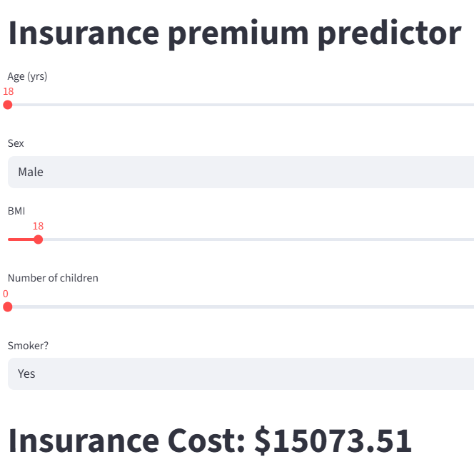
Model results and implementation
To demo, how this could look on the company website, I uploaded an app to Streamlit (right).
Customers can use sliding scales and selection boxes to input their details and predict insurance cost.
This is helpful as the customer get’s an idea of what their insurance might cost, which gives them more confidence in picking us.
To improve this model, we would feed it more data, to make the results more accurate.
This can be in the form of more fields or records, either would be beneficial.
Link to Streamlit
Github repo

Slide 13
Key findings and further analysis
Key findings:
Smoking has the largest effect on insurance costs, with smokers experiencing significantly higher premiums.
Age also has an effect although it is much smaller than that of smoking.
BMI only affects insurance costs, when the person also smokes.
Sex, region, number of children have no effect on insurance costs, whether the person smokes or not.
Further analysis
There is still an amount of variation for insurance costs within each category, which can’t be explained using the variables given.
More variables and more data should be included in future analysis to get a more complete picture of what affects insurance costs.
An explainable non-linear model, such as random forests, could be used to generate better predictions.
Final recommendations to the company:
Highlight that non-smokers are charged significantly less in marketing.
In fact, older or more unhealthy people can get better premiums than young people that smoke.
Implement model on company website to improve consumer confidence in our service.

